Slide 1
Renewable energy in the Loddon Mallee
Case studies – Oct 2019

Slide 2
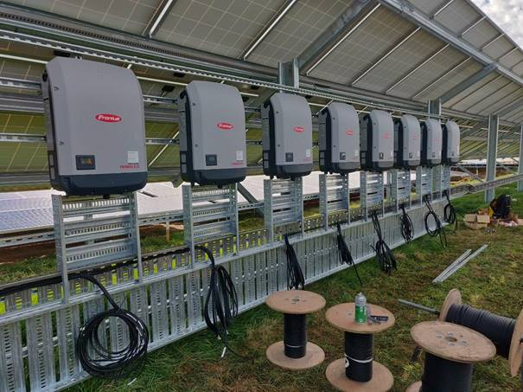
Hardwicks Meat Supply Kyneton – solar/battery microgrid
Need constant power for cool stores and freezers
$10M meat supplies at risk
$1.2M annual electricity bill
3MW solar and 2MW battery
Cut power bill by 60%
Can island in an outage
Can shift peak load by utilising battery in peak periods

Slide 3
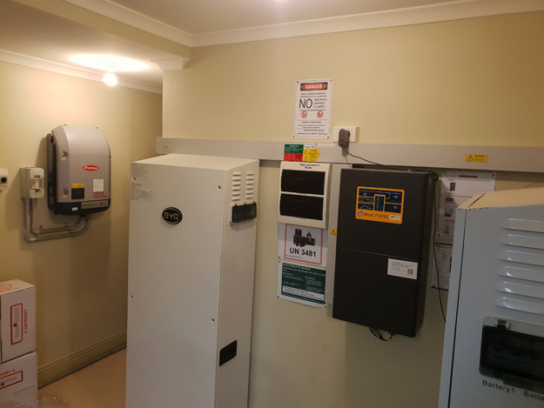
C
Lyttleton St Medical Clinic, Castlemaine
Invested $50K in solar and battery
system through MASH program
Previous summers experienced 3-4 blackouts
Servers go down and fridges with vaccines at risk
Phones can go down creating medical risks
BYD batteries can run in ‘island’ mode
Now have greater security of supply
Notes:
STCs for a $30K 30kw system already has $19K STCs taken off price.

Slide 4
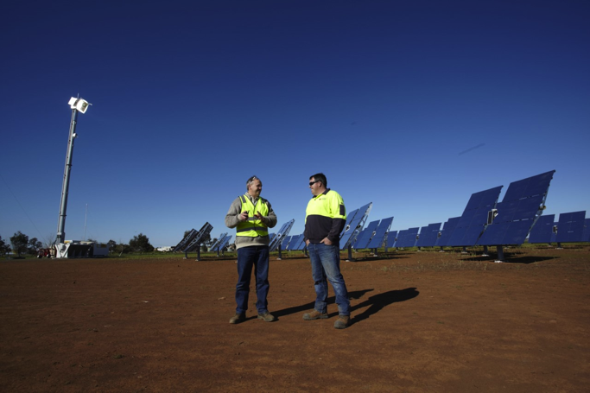
Raygen Resources Pty Ltd
Homegrown new energy tech
20 square metres of mirrors reflect on to ultra efficient solar panel (5000 x regular PV panel)
Turned into electricity (1MW) and heat (2MW)
Heat can be stored and used or converted later
Now sell tech to C&I customers
Electricity used by neighbouring mushroom farm ScatoPlus
Notes:
Gallium arsenide used by solar panels in space

Slide 5
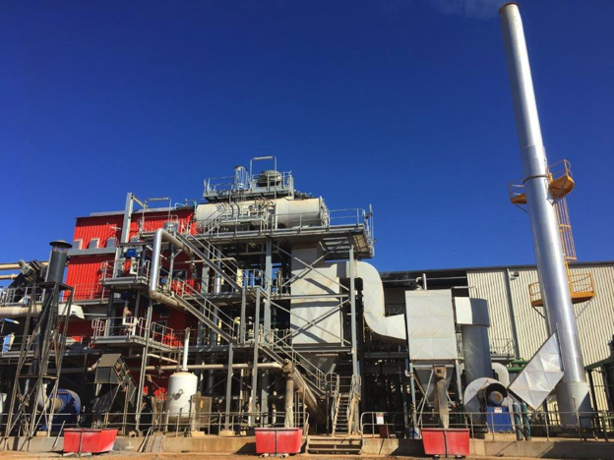
Select Harvests Bioenergy Plant
Converts 30K tonnes of almond waste (hulls, shells, tree prunings) to bioenergy
Steam to electricity generating 20,000MWh/year
Enough to run nut cracking plant and dam pumps
23,645 tCO2 cut annually
Creates 30K tonnes of potash spread over 7000 ha of orchards
Notes:
Gallium arsenide used by solar panels in space

Slide 6
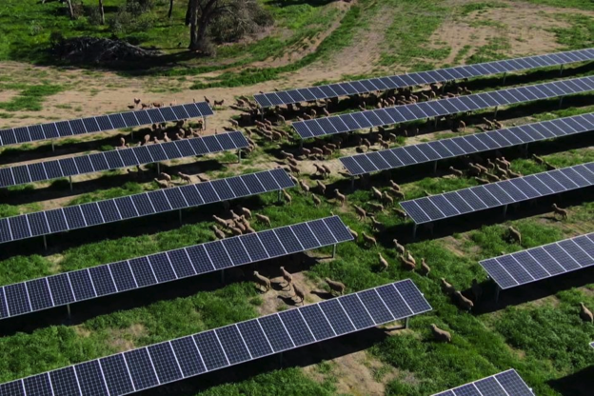
Numurkah Solar Farm
100 MW solar farm offsets Melbourne Tram network
Neoen made land available to former owner
Grazes 700 Merino Ewes under panels
Solar company benefits: Reduces fire risk and mowing/slashing costs
Farmer benefits: gets access to good fencing, shade, feed and shelter
Dew on panels can act as irrigation in dry periods
Notes:
Gallium arsenide used by solar panels in space

Slide 7
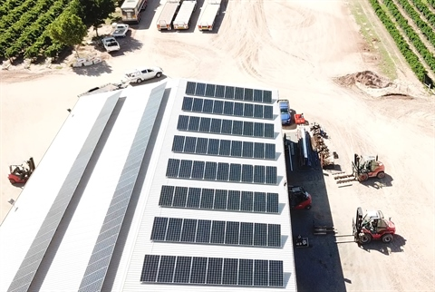
Englefields Wine Grape Services
Installed 52kW system
Slashed quarterly bills to $400 from $3500
Financed by a council Environmental Upgrade Agreement (EUA)
Cash flow positive from day one
Long term low interest loans
Can include other EE measures
Notes:
Gallium arsenide used by solar panels in space

Slide 8
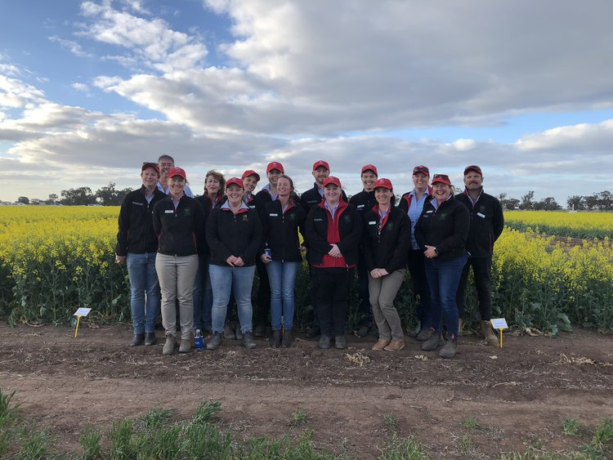
Birchip Cropping Group
Farmer driven farm research group
Microgrid with 55 1kW solar panels & 137kW battery = $346K ($210K – Vic Govt)
Battery powers drying lab at night – not commercially sensible
Connected to main power grid
Est as RE demonstration site for farmers & communities
Est annual power bill cut = $12,000
Turned on in July
Notes:
Gallium arsenide used by solar panels in space

Slide 9
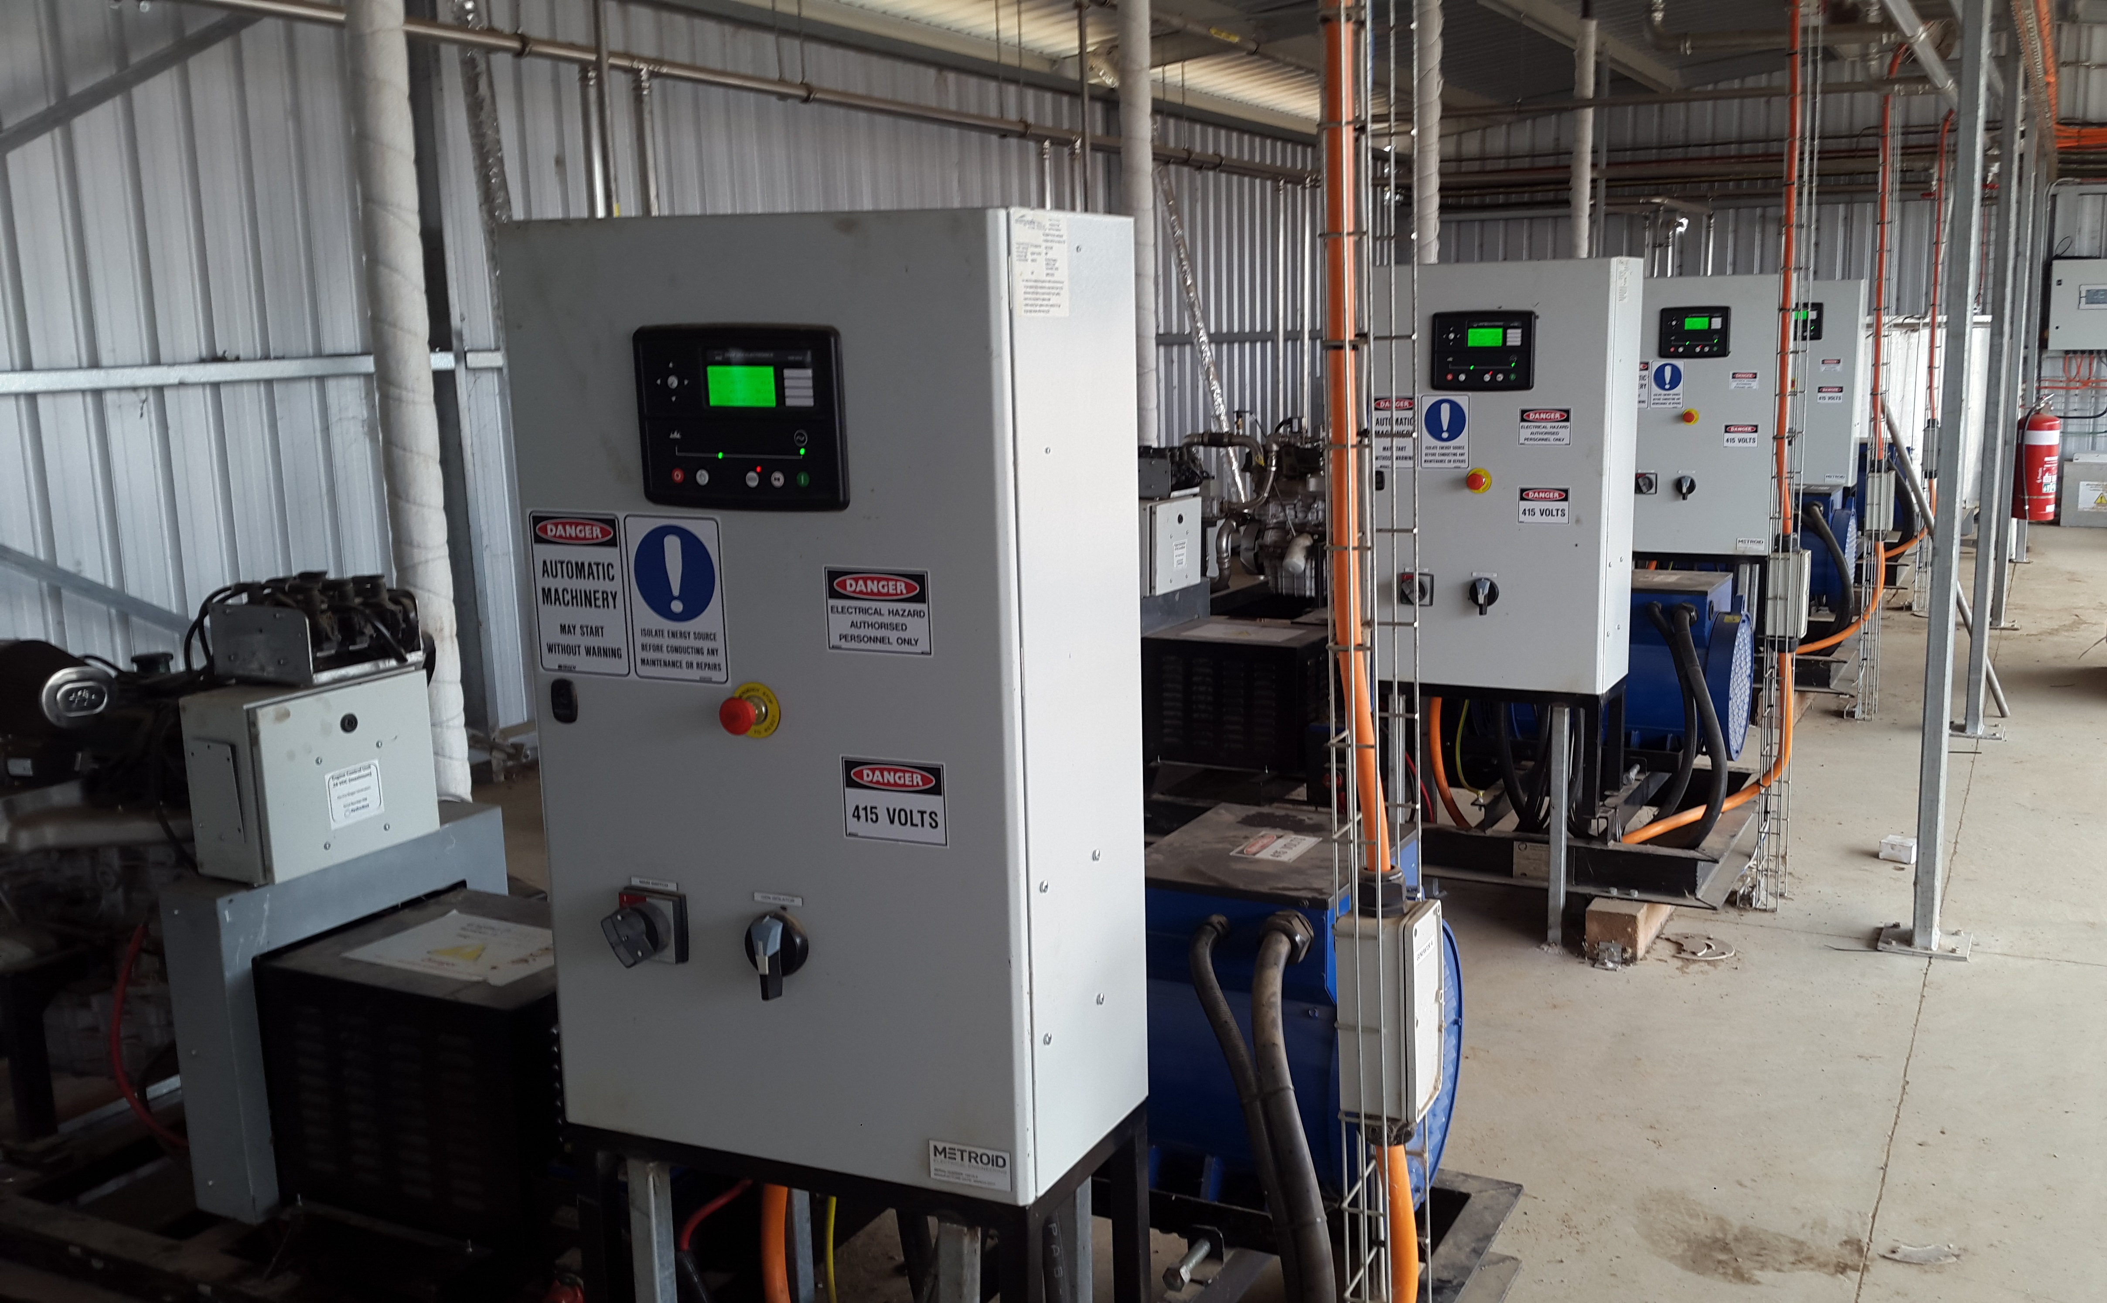
Kia-Ora Piggery
Produces 5,000 tonnes of effluent solids/yr
Collected in 20ML covered ponds
Generates 55-60% methane & 30% CO2
2nd-hand Ford Falcon motors modified to run on biogas
Cut farms annual power bill from $350K to $230K
Cuts equivalent 20,000t CO2/yr
Notes:
Gallium arsenide used by solar panels in space

Slide 10
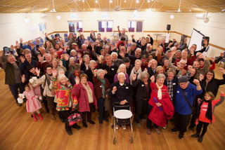
Renewable Newstead
Commercially viable small-scale solar
Business model established
Vic Govt $1m to help build solar farm
Distribution tariff is key
Aim to deliver RE to all not just those who can afford solar systems
Commercial partners to build & retail
Customer loyalty over 10 yrs might equal green energy credits
Notes:
Gallium arsenide used by solar panels in space

