Slide 1


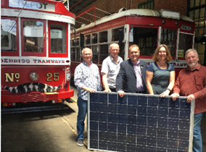
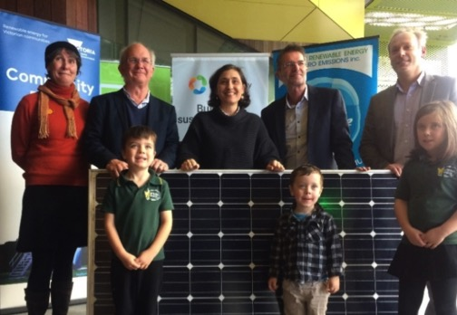

Opportunities for Community Energy in the Region
Experiences from the Bendigo Community Power Hub
Loddon Mallee Future Energy Forum
31 October 2019
www.bsg.org.au

Slide 2
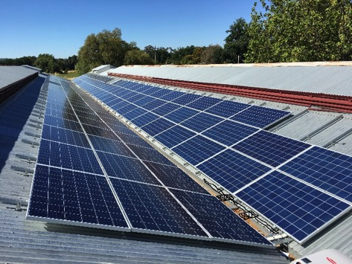

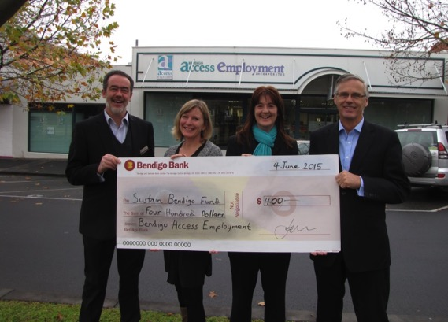

Agenda
Bendigo Sustainability Group
Community Power Hub Program
Why is Community Energy important?

Slide 3
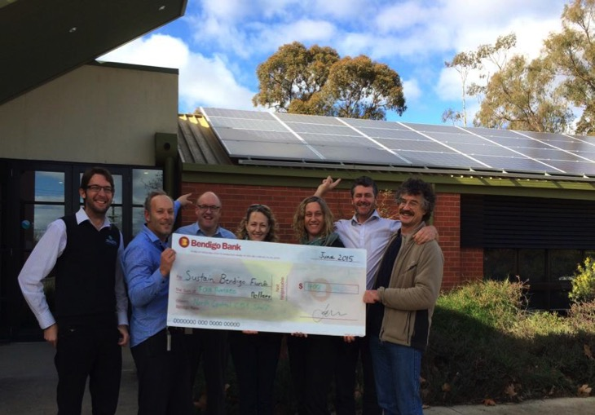
Bendigo Sustainability Group
NFP incorporated community group - founded in 2007
Multiple / many Action Groups
Premiers Sustainability Regional
Achievement Award
  2016 Winner
  2019 Finalist
BSG long history in solar PV
  Residential bulk buys
    650+ systems (2 MW)
  Community scale & owned
    6 x systems

Slide 4
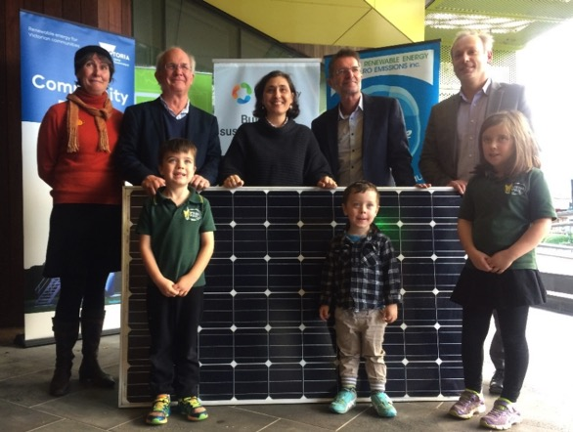
Community Power Hubs
State Government Funding
  Sustainability Victoria
Three locations nominated:
  Ballarat
  Bendigo
  Latrobe Valley
Two year program until June 2019
Promote and work out how to do Community Owned Renewable Energy for community benefit

Slide 5


BSG / CPH Vision
Repower Bendigo with:
  100% renewably generated energy
  100% community owned renewable energy (CORE)
$150+ million per year
spent on electricity
in urban Bendigo
  Households & business
CORE = Keep money
and benefits local
Notes:
1 min

Slide 6


BSG Community Scale / Owned Systems
Local BSG led projects
  2015 Bendigo Library 20 kW crowd funded BSG owned
  2016 Discovery Centre 11 kW crowd funded
  2017 Bendigo Tramways 50 kW CFCV funded
  2017 Bendigo Archives 31 kW BSG funded BSG owned
  2018 Eaglehawk Stadium 31 kW crowd funded BSG owned
  2018 8 x social housing units 31 kW crowd funded BSG owned
  Total 6 large solar PV systems 174 kW
    Over a 25 year period these systems will keep over
    $1.5 million here in Bendigo (& Central Victoria)
Notes:
3 min

Slide 7

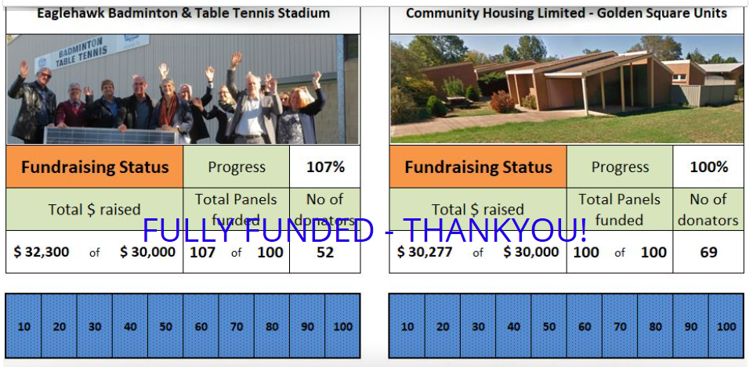
2018 Donation Projects

Slide 8
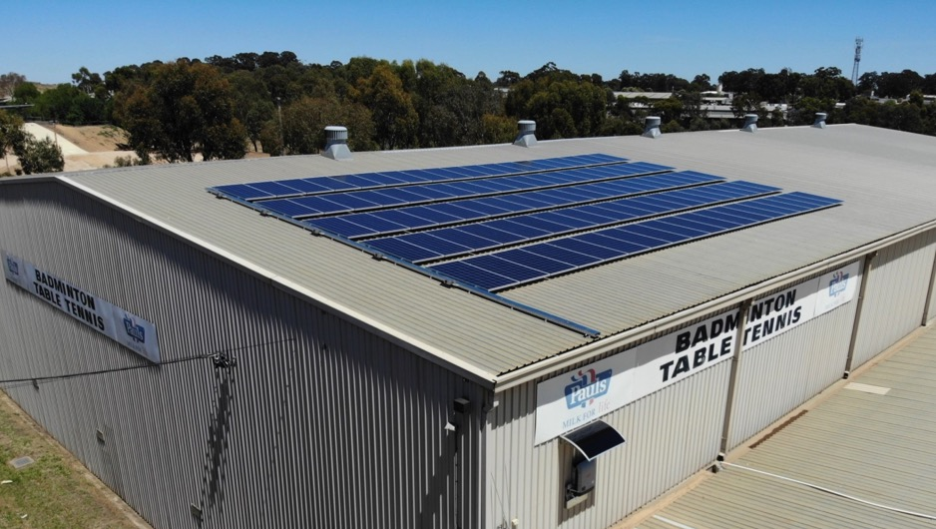

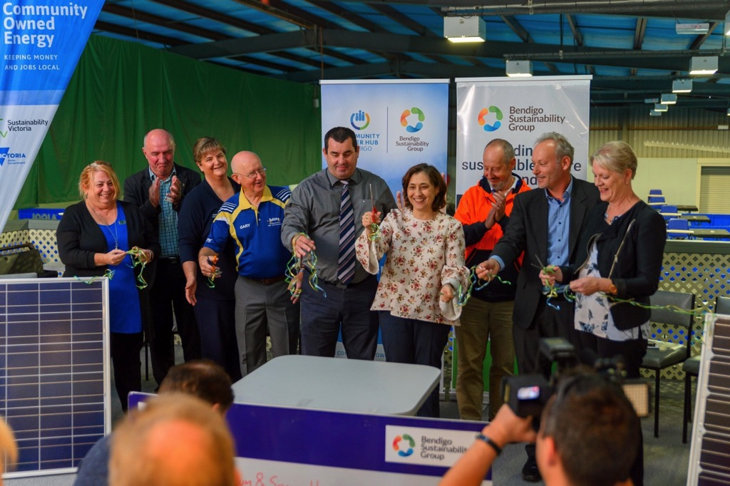
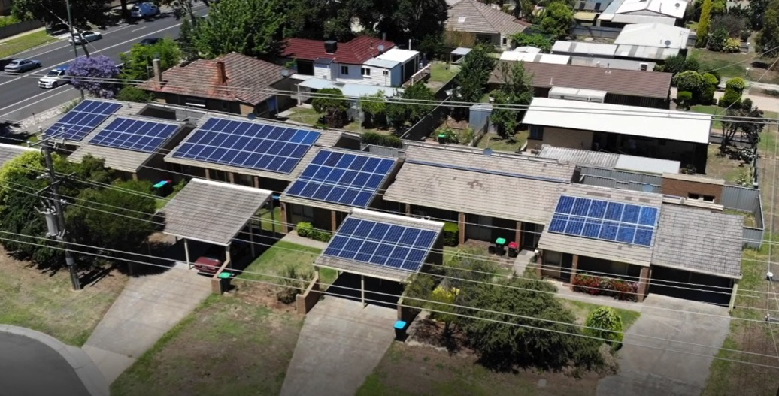
Eaglehawk Stadium
Social Housing

Slide 9


Slide 10
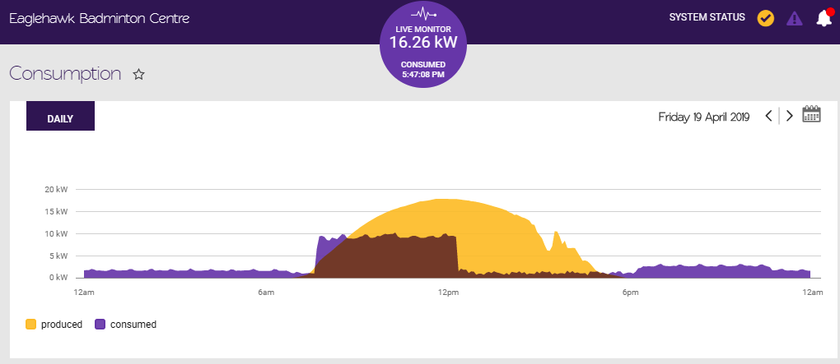

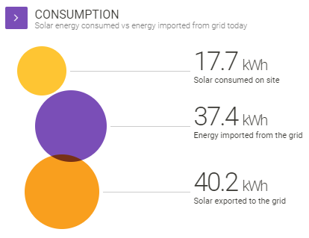
Live Monitoring of Projects

Slide 11
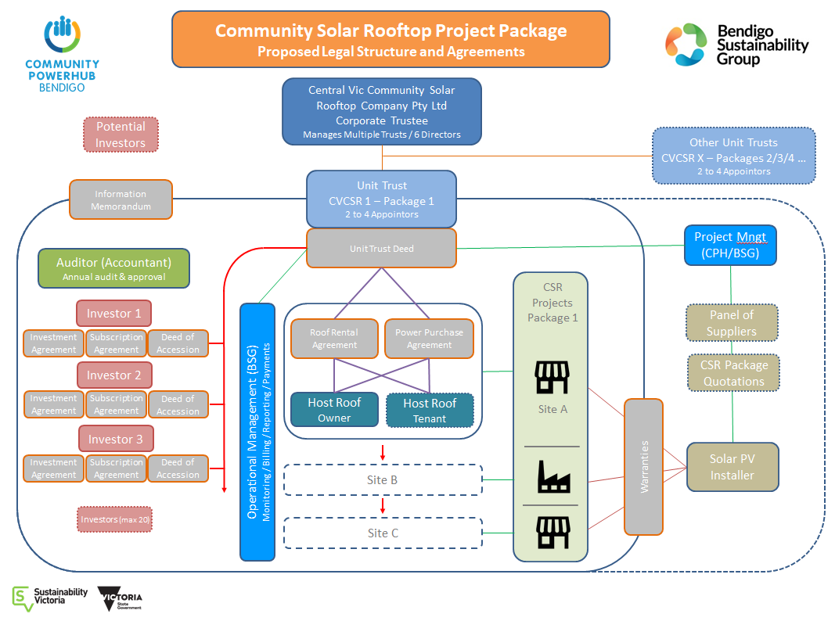
Rooftop Solar Investment Model

Slide 12

Government Schools
Working with local primary and secondary schools
Each site will have between 60 and 99 kW of solar PV
Up to $1.2 million in local community investment will be needed
Savings over 25 yrs – $8m and 38,000 tonnes of C0^{2-e}
Potential for Statewide roll out via CPHs

Slide 13

    Community Energy Development & Administration Group
Objectives / Purpose:
to assist and facilitate the development and ongoing operation of new, predominantly community owned, renewable energy projects across Central Victoria and beyond thus creating local jobs and keeping energy money locally within communities.
will provide ongoing operational administrative and other support services to maintain logistical and other viability of projects.
assisting the transition to a clean energy future, reducing greenhouse emissions, mitigating some affects of climate change and helping communities to adapt to our future changing climate.

Slide 14
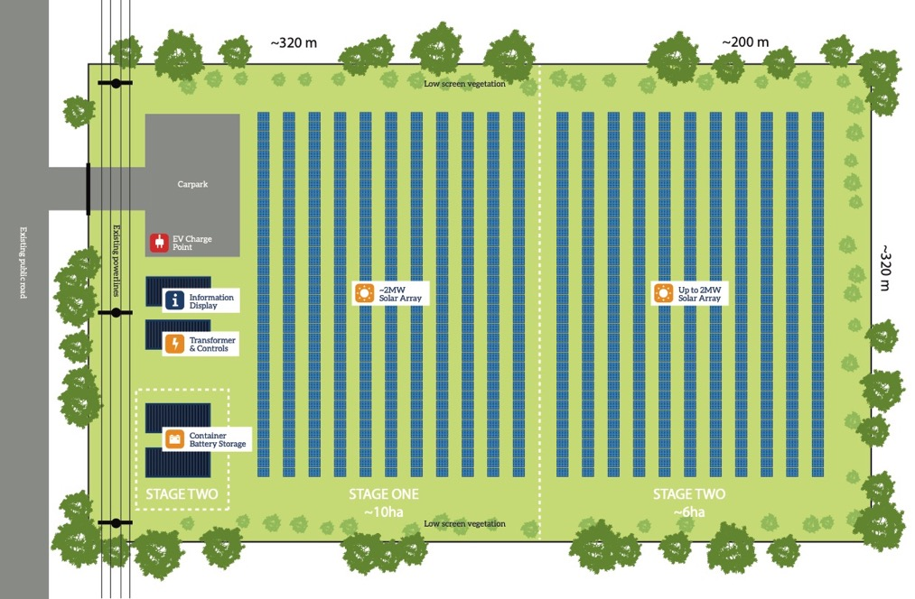
Community Mid-Scale Solar Farm
2 MWp DC solar farm (possibly plus additional solar & battery storage)
  $4 - 5 million in local community investment would be needed
  Will shortly be making offers on land from the public (approx 6 ha)

Slide 15
Community Solar Farms – the sweet spot
5 MW
Non-Registered Generator
Registered Generator
2 MW
Low Voltage
High Voltage
up to 2 MW
Additional
PV & Battery Storage
2 to say 15+ MW
say 15+ MW
Community Solar Farm
Less / unviable Solar Farm scale ??
Commercial Scale Solar Farm
The Sweet Spot
2 MWp / 1.5 MW AC - Low voltage
Direct to 22 kVA Distribution network
Quick, affordable connection and replicable
2 MWp

Slide 16
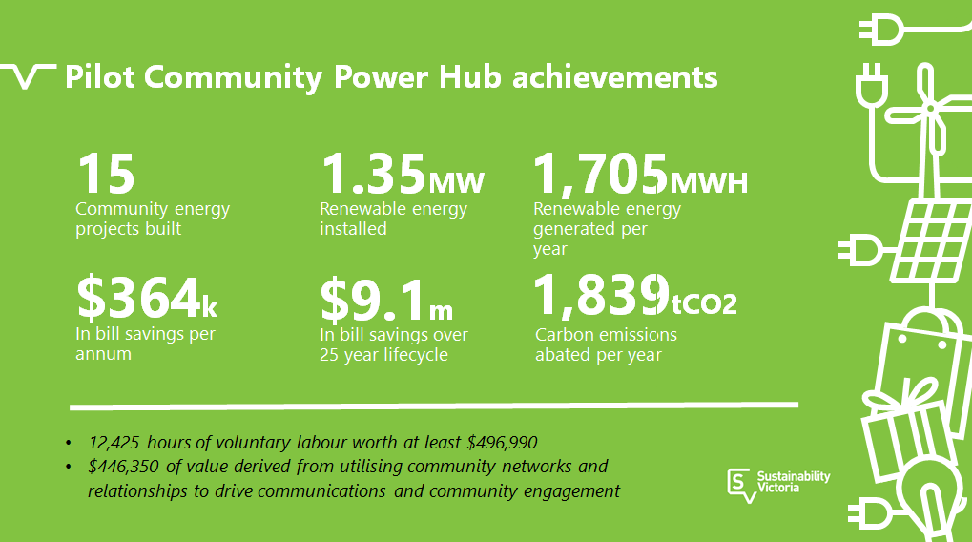

Slide 17
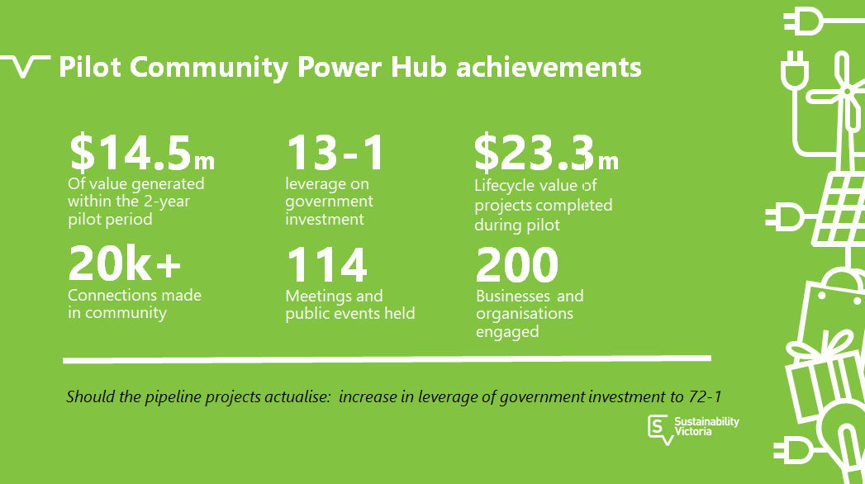

Slide 18
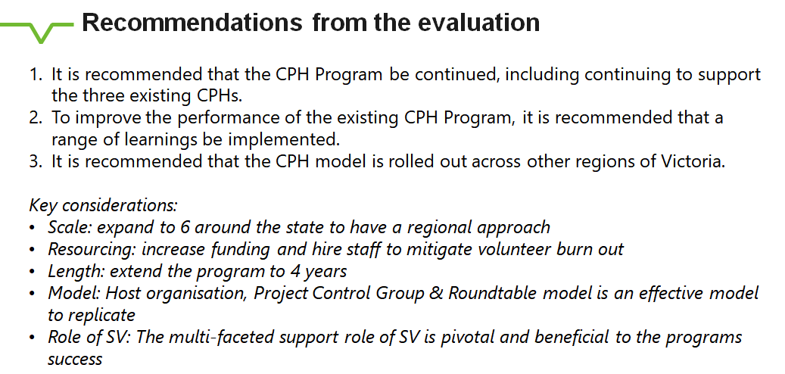
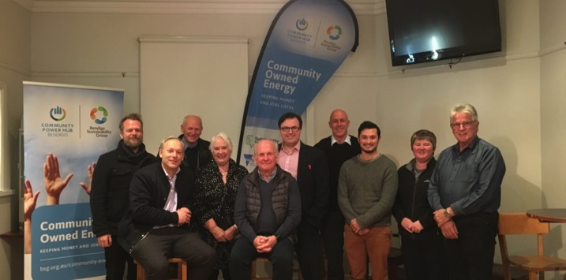

Slide 19

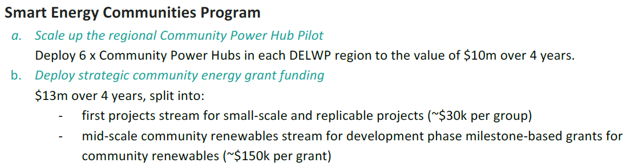
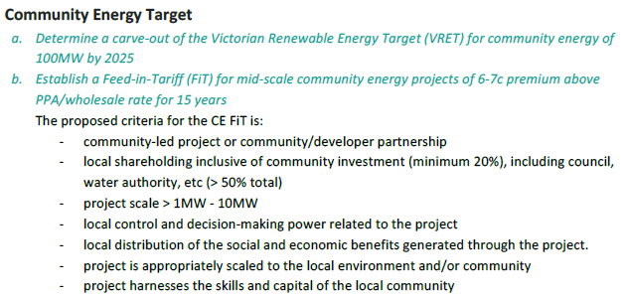

Slide 20
Community Buildings – Solar & Batteries
E.g. City of Greater Bendigo has over 500 buildings > 100 m2 roof area
Solar PV capacity using 25% of roof area = 6 MW
Community investment required = $6.6 million
Annual clean energy generation = 32,000 GJ
Estimated total energy offset / savings = 23%
25 yr community benefit = over $27 million
8,000 tonnes of C0^{2-e} savings per year
Potential for Statewide roll out via CPHs
Working with DELWP on licencing / PPAs (applicable Statewide)
Need Councils & Gov’t to lower barriers to buying from community

Slide 21
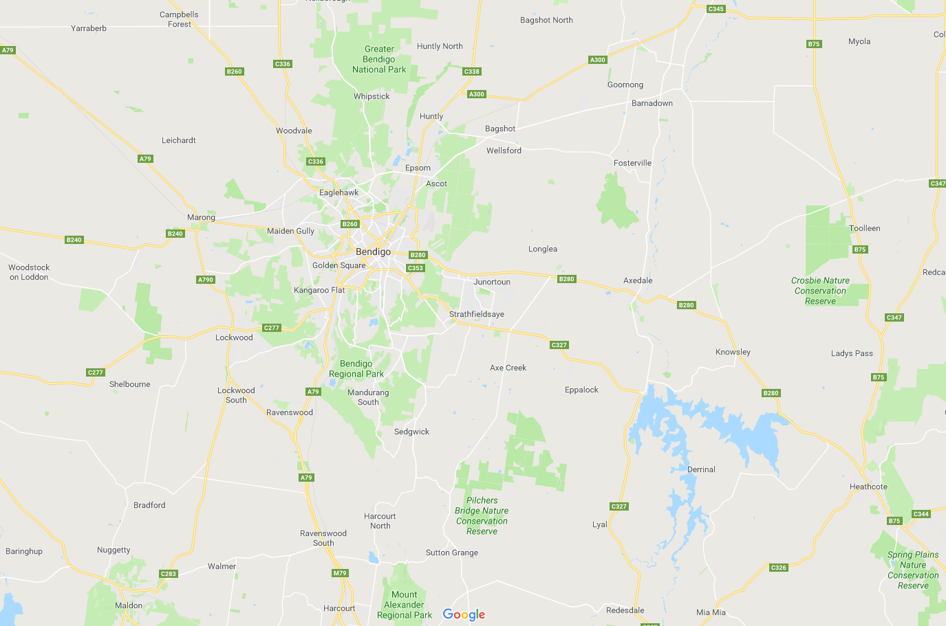


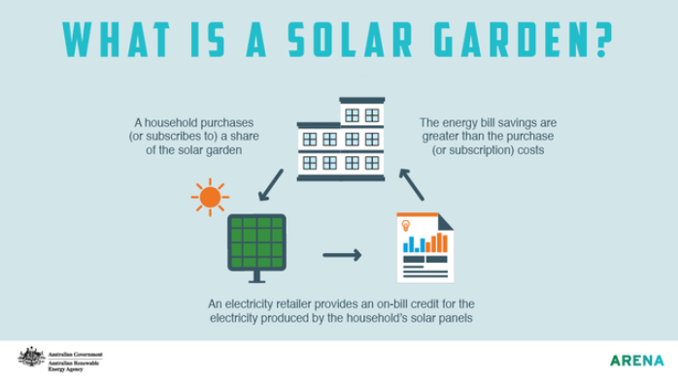
Community Power Hub Bendigo
General Indication of Potential Community Scale Solar Farms
Random indicative locations ONLY
Random indicative locations ONLY
KEY - Random indicative locations ONLY
5 x 2 MW = 10 MW (Initial set)
5 x 2 MW = 10 MW (second set)

Slide 22
Funding Needed for: Community Energy & Community Power Hubs
Community energy projects are unique
Proportionately large direct and indirect local benefits
  Community funds (money stays local)
  Employment opportunities
  New pathways for environmental volunteering & climate action
  Strong economic & community development outcomes
  New model of engagement around renewable energy
  Benefits the broader renewable energy sector
CPH Bendigo needs to be funded now to continue

Slide 23
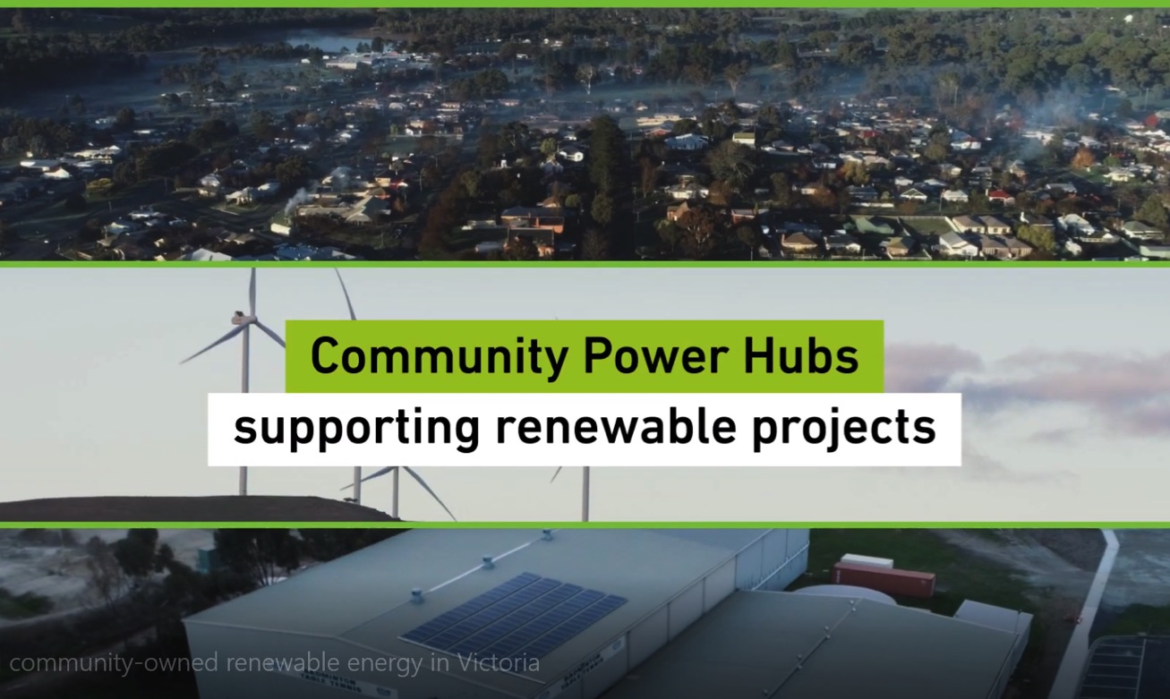

Slide 24
Opportunities for Community Energy in the Region
Experiences from the Bendigo Community Power Hub
Loddon Mallee Future Energy Forum
31 October 2019
www.bsg.org.au

